Slide 1
Econ 106: Data Analyis for Economics Lecture 11
slides adapted from: https://r4ds.had.co.nz/tidy-data.html

Slide 2
Reminders
Lab #3 is due Sunday, 11:59pm
Please remember to turn in MS #1 by 11:59pm tonight (5% late penalty is better than getting a zero)
https://pollev.com/vsovero
Notes:
In brief, we’ll
1. Introduce the R programming language and the RStudio interface
2. Discuss how operators and functions work
3. Investigate the structure of data frames

Slide 3
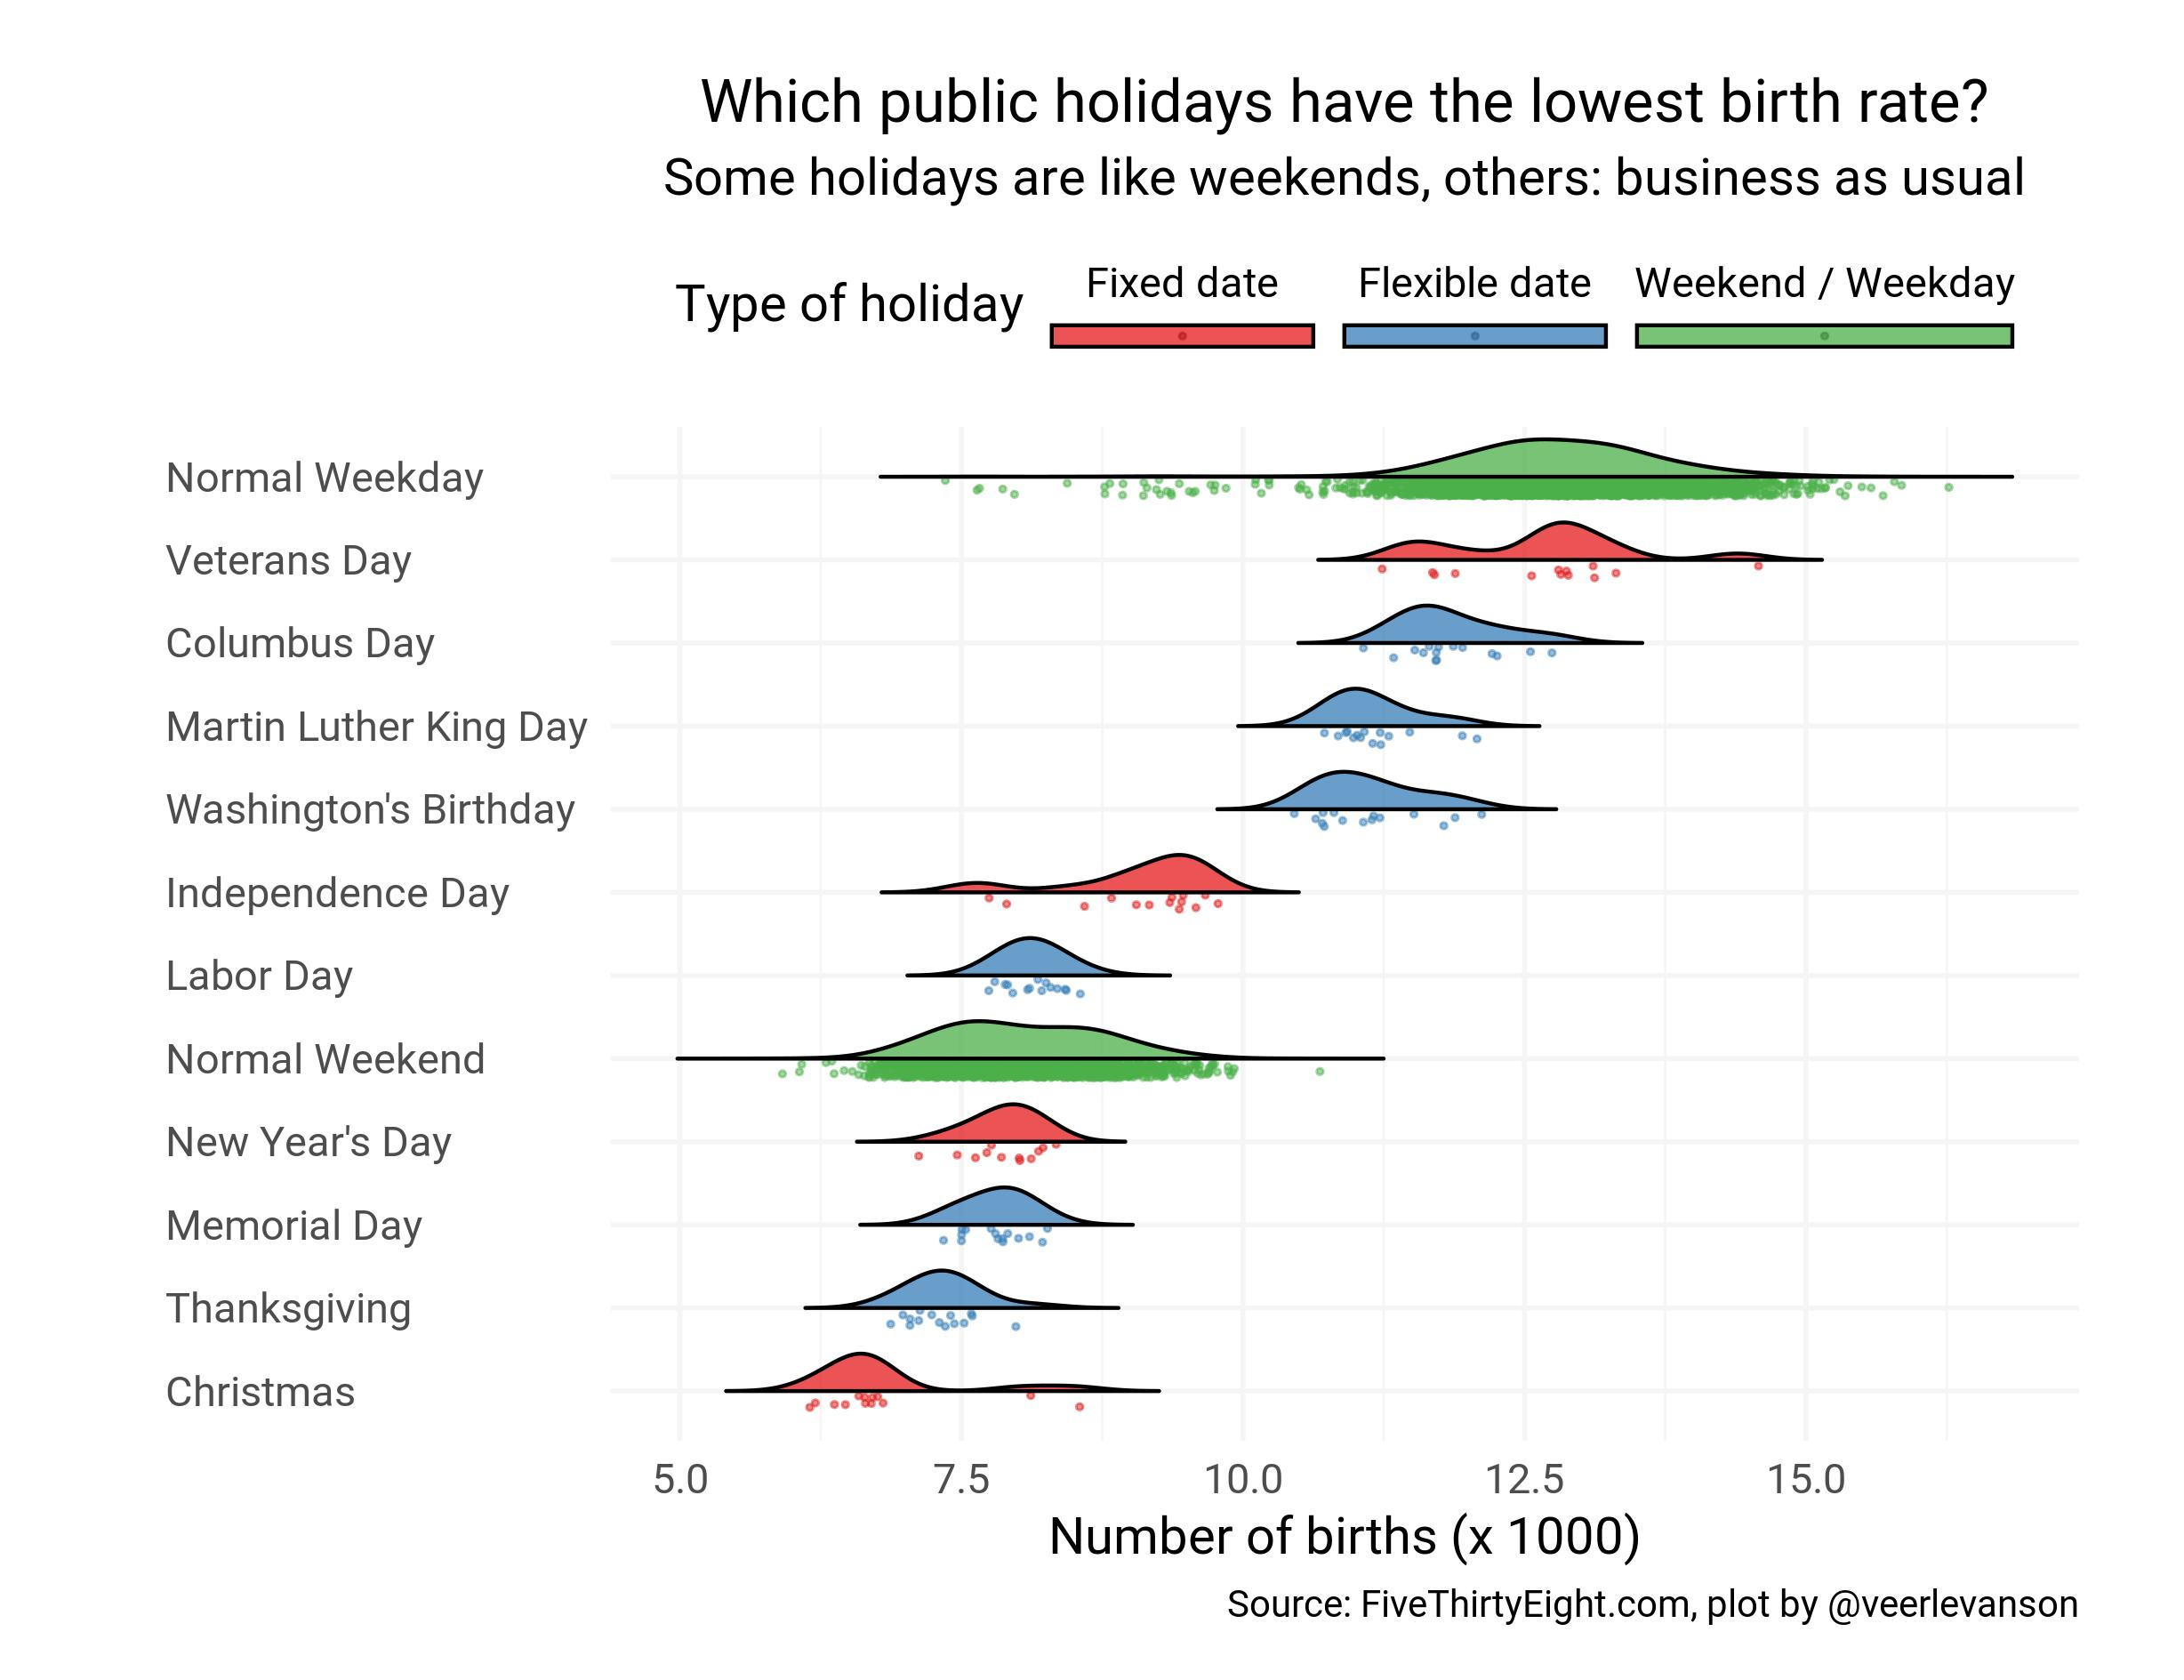
#tidytuesday
Remember, you need to also be able to interpret your visualization

Slide 4
Outline
Tidy data
reshaping
separate
Notes:
In brief, we’ll
1. Introduce the R programming language and the RStudio interface
2. Discuss how operators and functions work
3. Investigate the structure of data frames

Slide 5
Data in the Wild
Unfortunately, ”real data” is going to be messy
Each data set is messy in its own unique way
Our job as analysts is to untangle the mess before we can conduct any sort of analysis
This week, we are going to learn some tools for tidying data

Slide 6
What is Tidy Data?
each row is an observation
each column is a single variable
data is rectangular
if there are multiple data tables, they should have an identifier that allows them to be joined together

Slide 7
Why do we want Tidy Data?
Tidy data require only a small set of tools to be learned:
When using a consistent data format, only a small set of tools is required (dplyr for example)
these tools can be reused easily from one project to the next
Tidy data allow for datasets to be combined:
Data are often stored in multiple tables or in different locations.
By getting each table into a tidy format, combining across tables or sources is easy

Slide 8
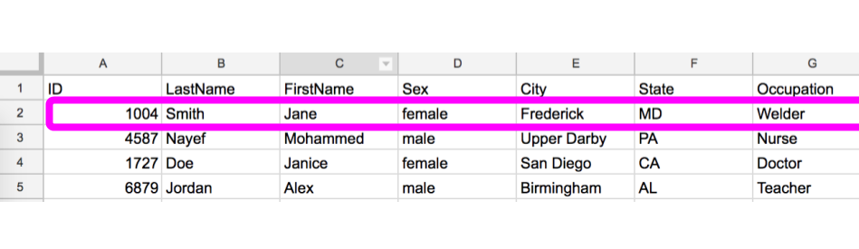
Each row is an observation

Slide 9
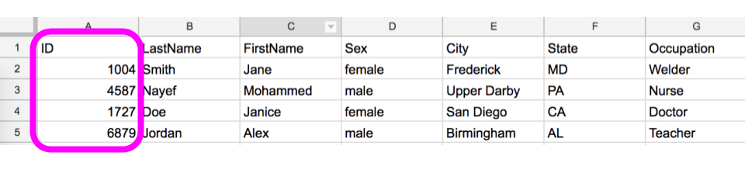
Each variable has it’s own column

Slide 10
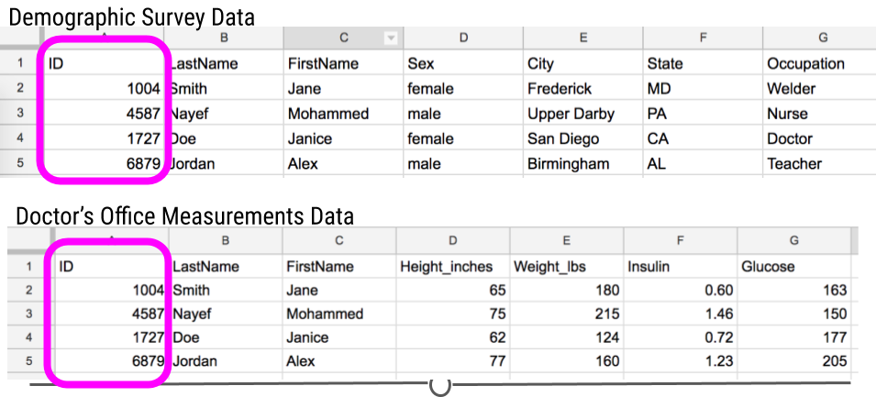
Each dataset has an identifier for joins

Slide 11
Messy Data
Common problems with untidy data:
Column headers are values but should be variable names.
A single column has multiple variables.
Variables have been entered in both rows and columns.
Multiple “types” of data are in the same spreadsheet.
A single observation is stored across multiple spreadsheets.

Slide 12
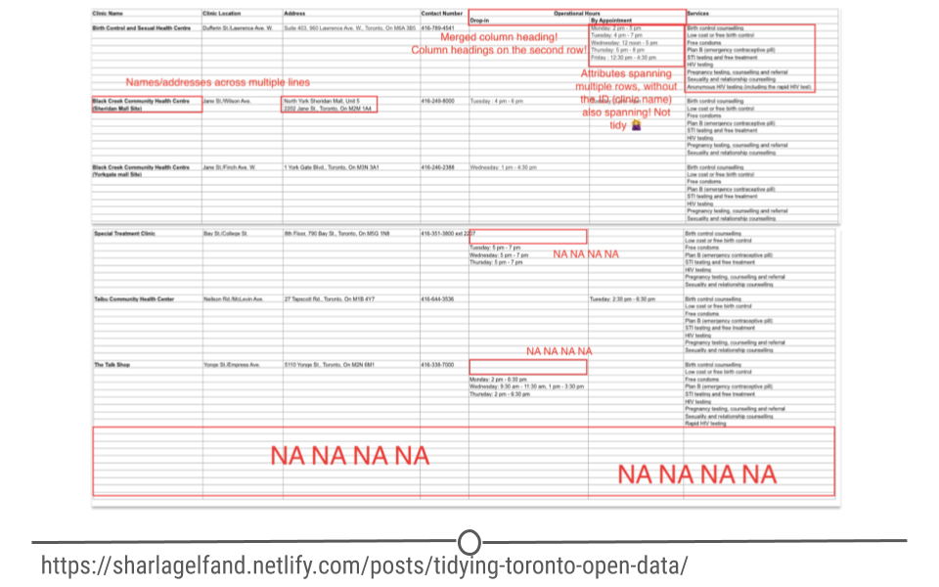
Messy Data Example

Slide 13
Example: TB data
Each dataset shows the same values of four variables:
country
year
population
number of documented cases of TB (tuberculosis)
However, each dataset organizes the values in a different way
data(table1)
data(table2)

Slide 14
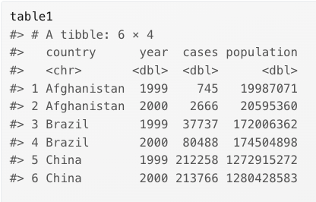
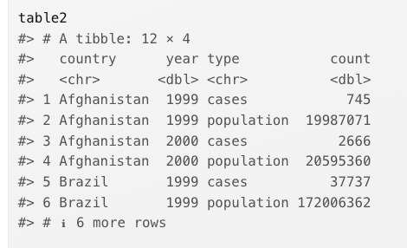
Same data, different layout
table1
table2

Slide 15
Exercise: How would you calculate the case rate by country?
table1

Slide 16
How would you calculate the case rate by country?
table2

Slide 17
Reshaping Data
Sometimes our data requires reshaping in order to be tidy
converting columns into rows (make your data longer)
converting rows into columns (make your data wider)
There are tools in the tidyverse that can do this reshaping for you

Slide 18
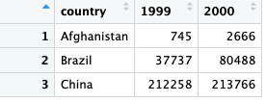
Example: TB Cases (Table 4a)
Problems:
Column names in this dataset represent years
Values in the 1999 and 2000 columns actually represent TB cases
Solution:
We need to reshape from wide to long

Slide 19
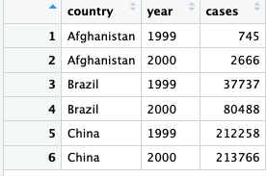
Reshaping Data: Wide to Long
What are the changes need to go from the table on the left to the table on the right?

Slide 20
Wide to Long Breakdown: Cases
currently cases by country are stacked horizontally (wide)
We need stack cases by county vertically (long)

Slide 21
Wide to Long Breakdown : Cases
We do this process one row at a time:
Afghanistan cases are stacked vertically
Brazil cases stack are stacked vertically
Chinca cases stack are stacked vertically

Slide 22
Wide to Long Breakdown : Cases
All the cases will be now be in a single column

Slide 23
Wide to Long Breakdown: Year
The 1999 and 2000 column names go into a new column called “year”

Slide 24
Wide to Long Breakdown: Year
The year column helps us tell which year the case data comes from:
745 cases in Afghanistan in 1999
2666 cases in Afghanistan in 2000

Slide 25
Wide to Long Summary
Cases stack into a single column
1999 and 2000 move from column headings into a single column

Slide 26
pivot_longer()
We need to specify:
The set of columns that need to be stacked into a single row
case_data <- table4a %>%
pivot_longer(cols= c(`1999`, `2000`),
names_to = "year",
values_to = "cases”)

Slide 27
pivot_longer()
We need to specify:
Alternatively, you can deselect the variable you don’t want to pivot (country)
case_data <- table4a %>%
pivot_longer(-country),
names_to = "year",
values_to = "cases")

Slide 28
pivot_longer()
We need to specify:
names_to: the name of the variable to move the column names to
case_data <- table4a %>%
pivot_longer(-country),
names_to = "year",
values_to = "cases")

Slide 29
pivot_longer()
We need to specify:
values_to: the name of the variable to move the column values to
case_data <- table4a %>%
pivot_longer(-country),
names_to = "year",
values_to = "cases")

Slide 30
pivot_longer() additional options
https://tidyr.tidyverse.org/reference/pivot_longer.html#ref-examples

Slide 31
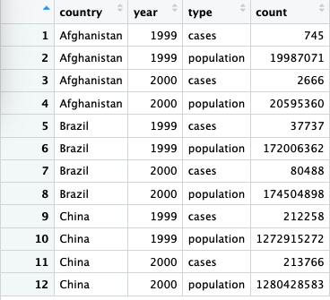
Example (table2)
Problems:
The Type variable contains variable names instead of values
Count has values of more than one variable
Solution:
we need to reshape from long to wide

Slide 32
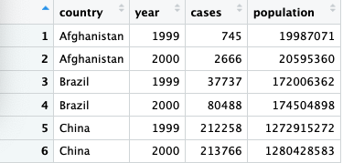
Long to Wide Breakdown: type
We take values from the type column and using them as new variable names

Slide 33
Long to Wide Breakdown: count
We stack values in count column horizontally instead of vertically (long to wide)

Slide 34
pivot_wider()
case_pop_data <- table2 %>%
pivot_wider( names_from =type,
values_from =count)
We need to specify:
names_from : The column to take the variable names from

Slide 35
pivot_wider()
case_pop_data <- table2 %>%
pivot_wider( names_from =type,
values_from =count)
We need to specify:
The column to take values from

Slide 36
pivot_wider()
case_pop_data <- table2 %>%
pivot_wider( names_from =type,
values_from =count)

Slide 37
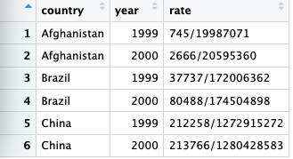
Splitting values into multiple columns
In table3, the rate variable needs to be split into two columns

Slide 38
Separate()
Arguments
col: The name of the existing variable whose values you want to split
into: The name of new variables where the split values will be moved into
sep: The string used to identify where to make the split
convert: whether you want the new variables to be converted to numeric
table3_separated <- table3%>%
separate(col=rate,
into = c("cases", "population"),
sep = "/”,
convert=TRUE)

Slide 39
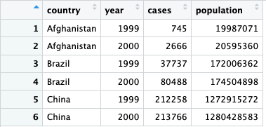
Separate()
table3_separated <- table3%>%
separate(col=rate,
into = c("cases", "population"),
sep = "/",
convert=TRUE)

Slide 40
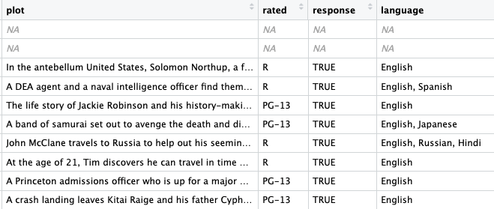
Splitting values into multiple rows
In this table, the language column has multiple languages listed

Slide 41
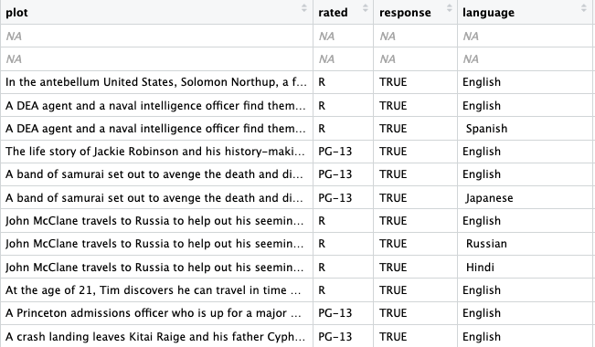
Splitting values into multiple rows
Let’s create a new row for every language listed in a movie

Slide 42
separate_rows()
We need to specify:
The variable whose values you want to split
The character used to identify where to make the split
movies_language <- movies%>%
separate_rows(language,
sep = ”,")

Slide 43
separate_rows()
https://pollev.com/vsovero
movies_language <- movies%>%
separate_rows(language,
sep = ”,")
Result: row for every movie-language pair

Slide 44
Exercise
Use the movies data frame to do the following:
calculate the average domestic gross by genre (keep the top 5)
separate the genre variable, then calculate the average domestic gross by genre (keep the top 5)
Why are these tables different?

